Slide 1
Heap
Data Structure
Presented by - Atharva Ambade lk3392

Slide 2
Unsorted Array
Time Complexities:
Insert -> O(1)
Search -> O(n)
Find_min -> O(n)
Delete_min -> O(n)

Slide 3
Sorted Array
Time Complexities:
Insert -> O(n) -> using insertion sort
Search -> O(logn) -> Using Binary Search
Find_min -> O(1)
Find_max -> O(1)

Slide 4
Linked List
Time Complexities:
Insert -> O(1)
Search -> O(n)
Find_min -> O(n)
Delete_min -> O(n)

Slide 5
Heap vs. Other Data Structures
Why Heap?
Three operations are optimized:
Insertion
Finding Minimum
Deleting Minimum
 | Insert | Search | Find_Min | Delete_Min
Unsorted Array | O(1) | O(N) | O(N) | O(N)
Sorted Array | O(N) | O(logN) | O(1) | O(N)
Linked List | O(1) | O(N) | O(N) | O(N)
Min Heap | O(logN) | O(N) | O(1) | O(logN)

Slide 6
Definition:
A heap is a specialized tree-based data structure that satisfies the heap properties which are:
It is a complete binary tree where all levels are filled except possibly the last one, which is filled from left to right.
It follows the complete properties of either Min Heap or Max Heap
Heap with N nodes has a height of logN
Types of Heap:
Max-Heap: The root element is the largest.
Min-Heap: The root element is the smallest.
Array Representation (C++):

Slide 7
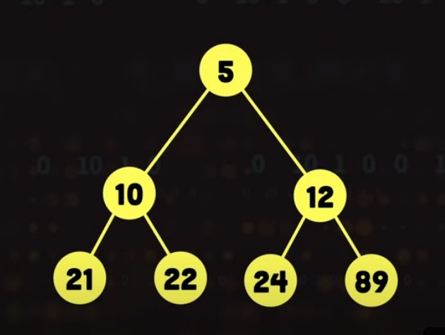
Min Heap
Every parent node is less than or equal to its children.
Value(Parent)<=Value(Child)
As all the properties of Heap and min Heap are being fulfilled, this can be proved as Mix Heap

Slide 8
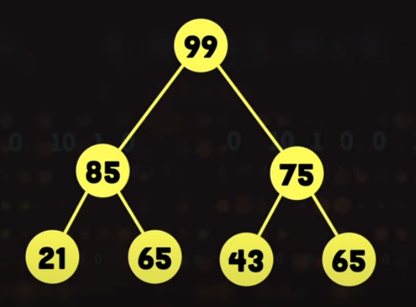
Max Heap
Every parent node is greater than or equal to its children.
Value(Parent) >= Value(Child)
As all the properties of Heap and Max Heap are being fulfilled, this can be proved as Max Heap

Slide 9
Array Representation (C++)
Store the heap elements in an array.
For a node at index i:
Left child: 2i + 1
Right child: 2i + 2
Parent: (i - 1) // 2
This makes it easy to traverse and manipulate heap elements efficiently.

Slide 10
Insertion
New Node is inserted from Top to Bottom and
Also the inserted node should be from Left to Right
40
31
34
40
9
33
11
10
4
85
21
5

Slide 11
To Arrange it correctly let's compare the nodes with parent and will convert this Heap into Min Heap
40
31
31
31
40
40
34

Slide 12
31
31
9
40
34
9
34
31
34
9
40
40
9
9
9
11
10
11
34
31
34
40
31
85
34
40
31
40
11

Slide 13
Similarly, we will Swap all the nodes, which has its parent node value greater than the child node value.
This is how we can insert a new node in a Min Heap.
In the Max Heap, the procedure is same, just while swapping if the parent node is smaller than the child node, then only we need to swap.
The Time complexity for the insertion operation is O(log n)
The Swapping Operation we performed while comparing the node with parent node is called Heapify

Slide 14
Heapify:
Heapify is the process of converting a binary tree into a valid heap structure (either a min-heap or max-heap). In a heap, the heap property must always be maintained:
In a min-heap, every parent node is smaller than or equal to its children.
In a max-heap, every parent node is larger than or equal to its children.
The heapify operation is primarily used in two scenarios:
When adding a new element to the heap (we heapify up).
When removing an element from the heap, particularly the root (we heapify down).
Heapify operations are crucial to maintaining the efficiency of heap-based data structures.
Both heapify up and heapify down run in O(log n) time due to the binary tree's height, ensuring that operations like insertion and deletion remain efficient.

Slide 15
Heapify Code in C++ for Max Heap
void heapify(int arr[], int n, int max) {
int root= max; // Initialize largest as root
int left = 2 * max + 1; // Left child index
int right = 2 * max+ 2; // Right child index
// If left child is larger than root
if (left < n && arr[left] > arr[root])
root= left;
// If right child is larger than the current largest root
if (right < n && arr[right] > arr[root])
root= right;
// If largest is not root
if (root!= max) {
swap(arr[max], arr[root]); // Swap root with the largest child
heapify(arr, n, root); // Recursively heapify the affected subtree
}
}

Slide 16
Deletion
For Min Heap
We delete the 1st Smallest value then the 2nd and then the 3rd smallest value
If the element is not specified, we swap the smallest or the root node with the last node
10 100 100 15
/ \ / \ / \ / \
15 30 -> 15 30 -> 15 30 After Heapify -> 40 30
/ \ / / \ / / \ / \
40 50 100 40 50 [10] 40 50 100 50
Here we can see, if we want to delete the root node 10, we'll need to first swap it with the last node i.e. 100
Once it is swapped we can delete the last node i.e. 10
After deleting, we'll need to perform Heapify to restore the Heap properties

Slide 17
Applications of Heaps:
Priority Queues:
Efficiently manage a set of tasks based on priority.
Heap Sort:
Sorting algorithm with time complexity O(n logn).
Graph Algorithms:
Dijkstra's Shortest Path Algorithm
Prim's Minimum Spanning Tree

